Slide 1

Xon
File Transfer Application

Slide 2
Team Members:
Project Guide:
Ms SATHYA S, M.E.,
Assistant Professor
Computer Science and Engineering Hindusthan College of Engineering and Technology,Coimbatore-32
18104077 Moovendiran S
18104088 Nivas paul P
18104090 Pavithran R
18104094 Prabu K

Slide 3
Contents:
Architecture
Abstract
introduction
ER Diagram
Literature Review
DFD Diagram
Existing System
Project Module
Proposed System
Screen Shots
Advantages
References
Conclusion
Software Requirements

Slide 4

Abstract
Xon this is what the application we are built. We are developing based on the principal, Distance= Speed × Time.
Through this app we are implementing the long distance file sharing option, Increasing the speed of file transfer, Decreasing the peer to peer connectivity time and also improving large size file sharing capacity.
Through this Xon application we will overcome the other file sharing application drawbacks.

Slide 5
Introduction:
File sharing is the practice of distributing or providing access to digital media, such as computer programs, multimedia (audio, images and video), documents or electronic books.It evolved from removable media via network protocols, such as File Transfer Protocol (FTP). Beginning in the 1990s, many remote file-sharing mechanisms were introduced, including FTP, hotline and Internet relay chat (IRC).

Slide 6

Literature Review:
File sharing, putting material online for others to take Internet piracy and file sharing has been increasing problem for organizations that rely on copyright. Pirating and file sharing have had noticeable impacts on various media industries, such as the music and motion picture industries, which claim to have lost a significant amount of income due to piracy. Because of this, many organizations within these industries wish to prevent and stop file sharing and pirating of their works and have actively supported such actions, such as with the recent Stop Online Piracy Act and Protect IP Act.

Slide 7
Existing system:
Disadvantages:
Does not work all time,
Only connecting with other devices in an allowed distance
It Takes much time to connect two devices
Need to Recreating the connection to send new file,
Must have wifi connection,Sometime depending on internet speed

Slide 8
Proposed System:
Being a high speed sharing tool,supporting to quickly connect and directly share data between 2 devices without any intermediate device.
Xon apk allows you to share all files such as photo, video, music, document, app and games that are installed on your mobile with another device quickly in a second.
This is an alternative to the traditional methods such as cable, USB. In Particular, Xon is superior with the speed of 40 times faster than Bluetooth speed Sharing all file types:
Photo, video, music, app, games,files and contacts

Slide 9
Advantages of Proposed System:
The user may Share all types of files:
photo, video, music, app, games and contacts
The transmission speed of xon is 40 times faster than Bluetooth
User change the preferences based on their choice.

Slide 10

Software Requirements:
Android studio
Windows 7/8/10 (64-bit)
4 GB RAM minimum, 8 GB RAM recommended.
2 GB of available disk space minimum, 4 GB Recommended
1280 x 800 minimum screen resolution
Java
RAM: 128 MB
Disk space: 124 MB for JRE; 2 MB for Java Update
Processor: Minimum Pentium 2 266 MHz processor
Figma.
MAC OS: Must be running 10.12 (macOS Sierra), or later.
Windows: Must be running Windows 8 or later in a 64-bit environment.

Slide 11
Architecture:
File transfer User Interface
Access Manager
Transfer
Manager
Access Interface
Transfer Interface
File Access
Sender
Receiver
File System
Transfer System

Slide 12
ER Diagram:
User name
password
Username
Guest
Register
Login
password
user
admin
Change password
sender
receiver
Updates
Photo
app
Files
Audio
Video

Slide 13
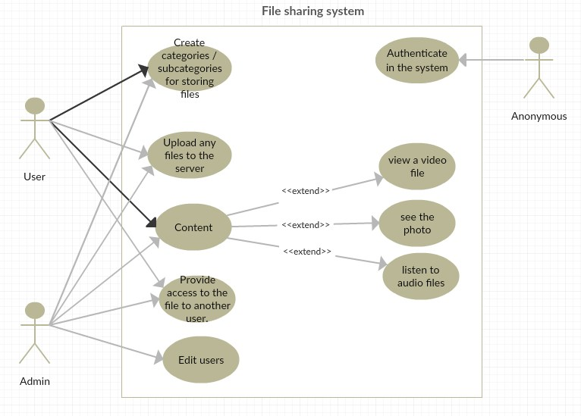
Use case Diagram:

Slide 14
DFD Diagram:
LEVEL 0;
SENDER
XON
RECEIVER

Slide 15
LEVEL 1;
SENDER
TRANSFER
File, audio, Video
XON
RECEIVER
Waiting for
SENDER

Slide 16
LEVEL 2;
File,Image,Audio,video
Waiting for Receiver
SEND
User id,
QR code,
Verification
WiFi, Bluetooth
Location
Transfering Files
Transaction success!
XON
Verification
RECEIVER
Waiting for
Sender
Bluetooth,Location

Slide 17
Project Module:
Initial Setup Module
In initial setup user need to allow application permissions.
Sender Module
In sender Module the user choose their media, What the receiver needs.

Slide 18
Receiver Module
In receiver Module the receiver will getting the multimedia files or any other files.
Main Menu
In the Main menu the user may change the application preferences based on their choice.

Slide 19

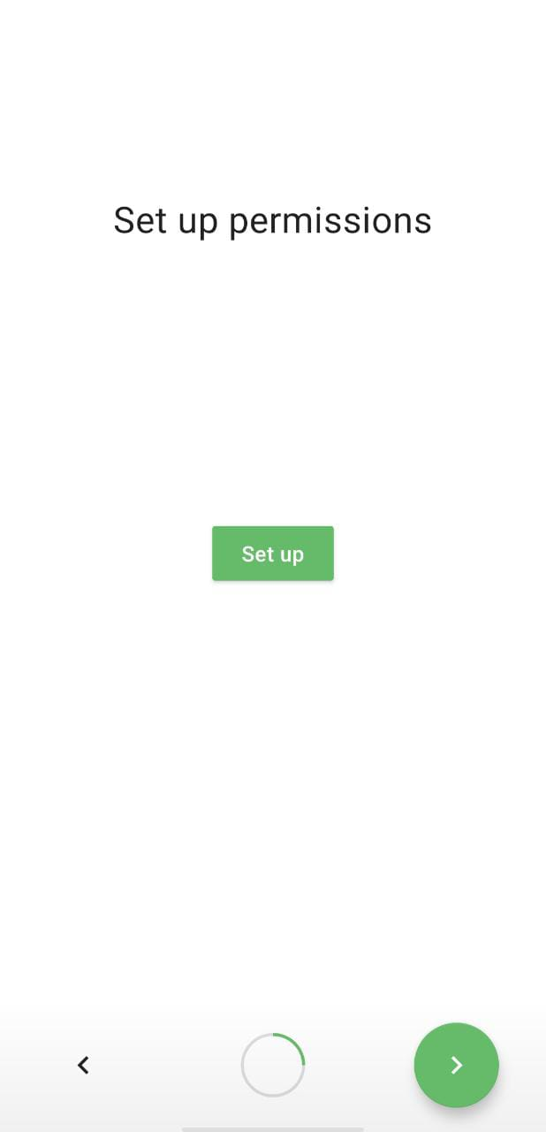
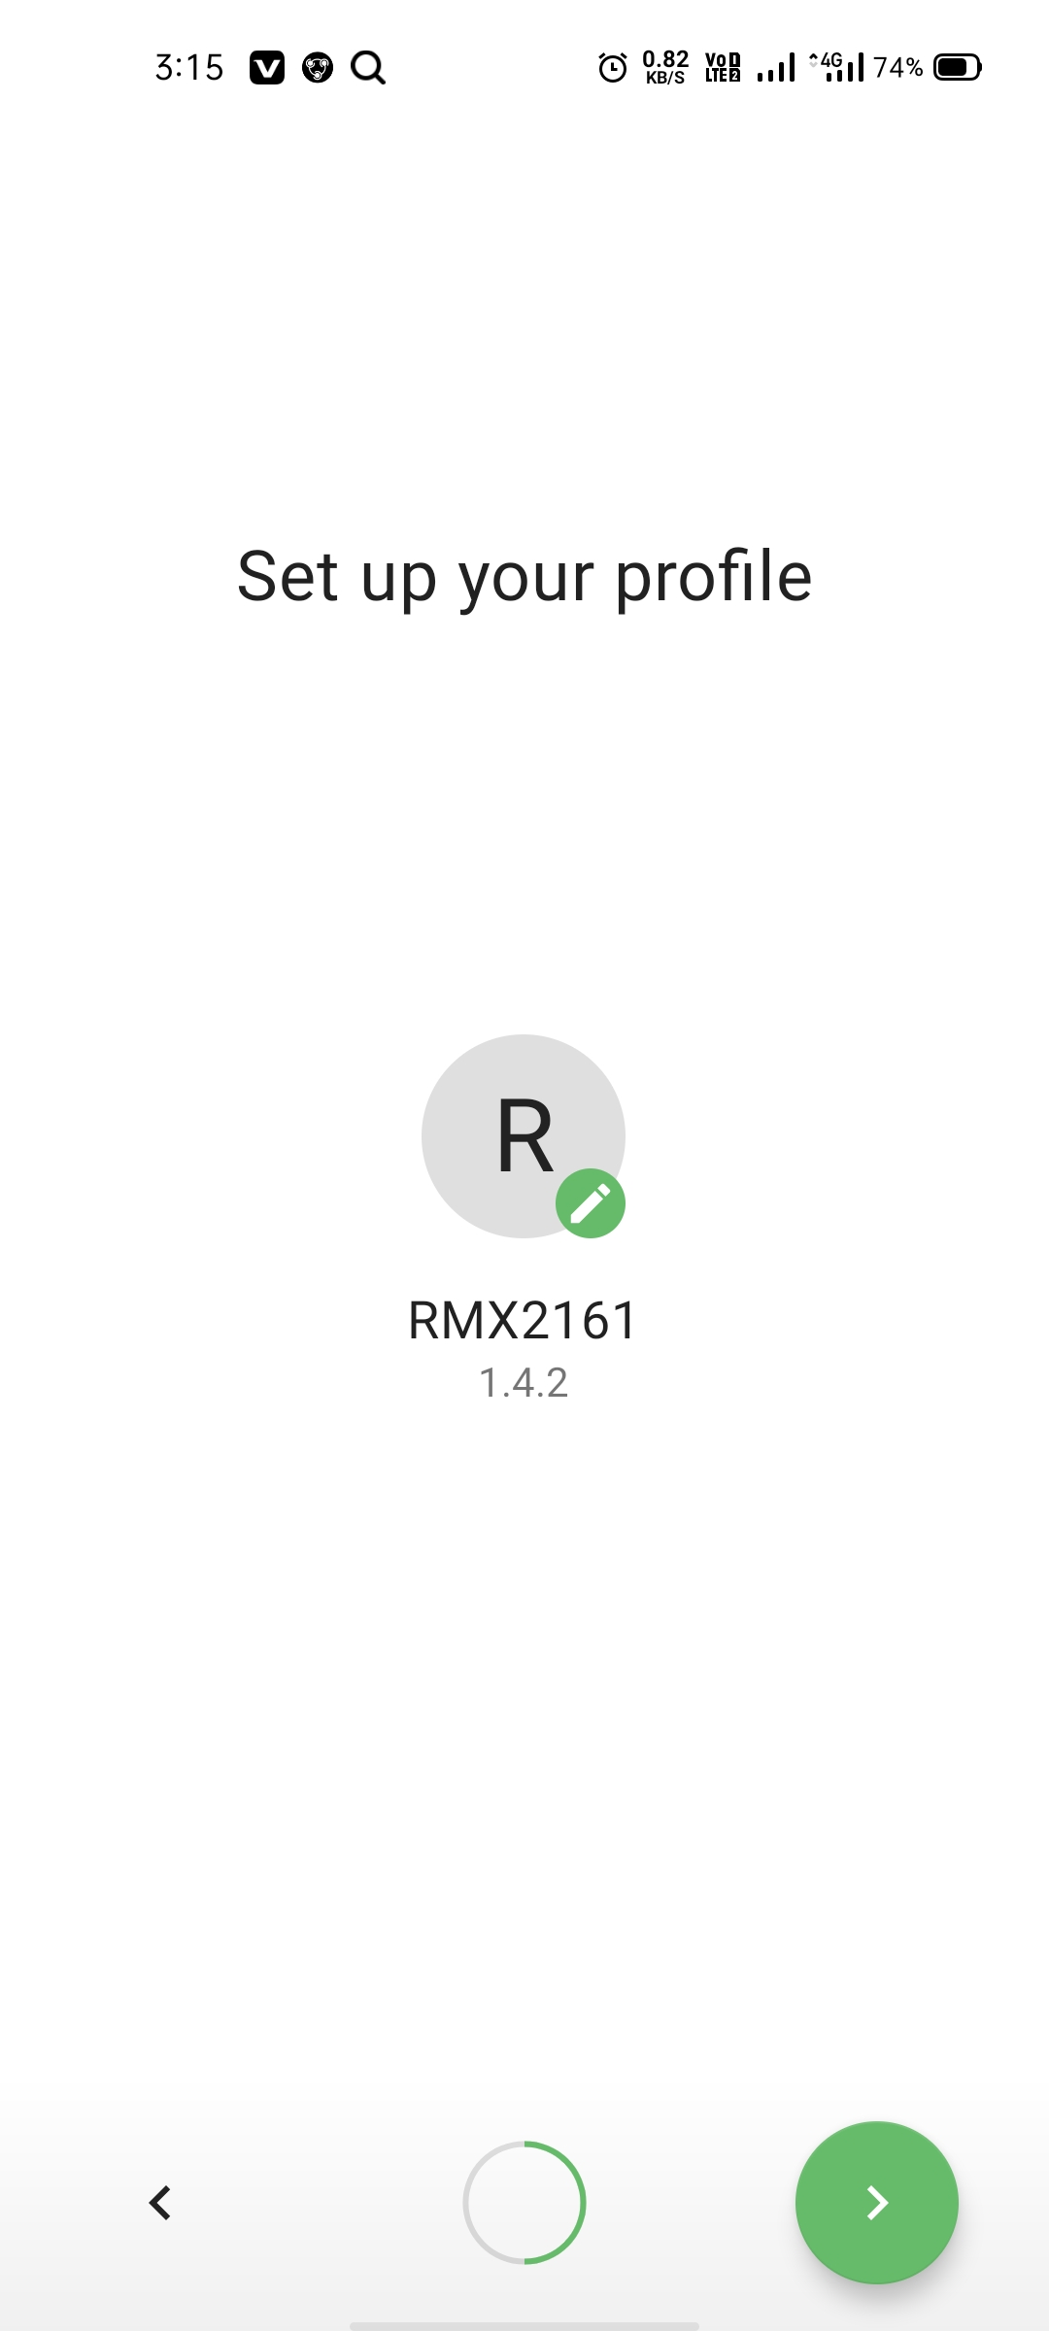
1.Initial Setup

Slide 20
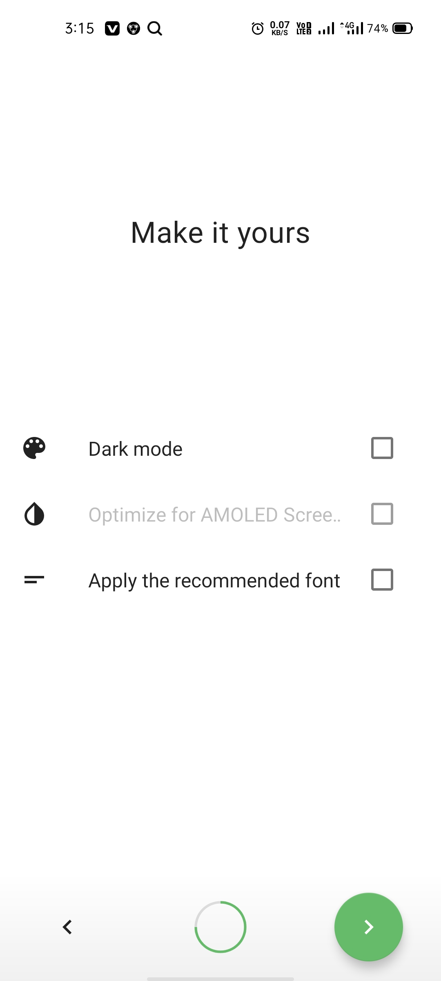
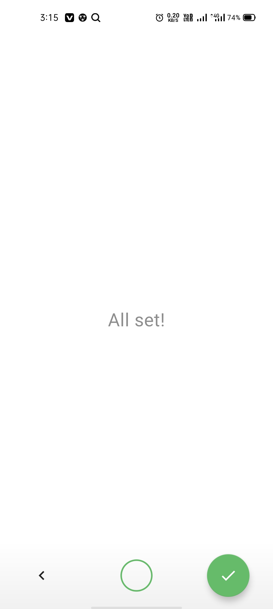
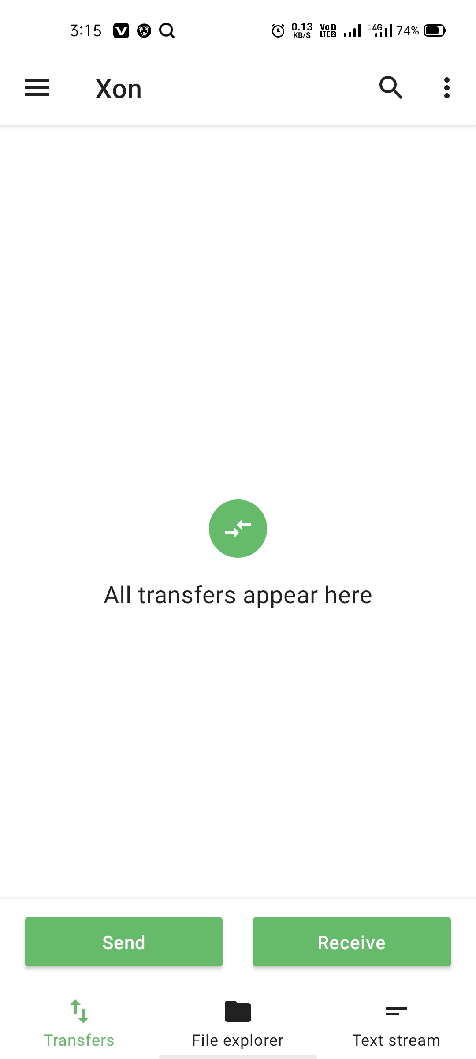
2.Home screen

Slide 21
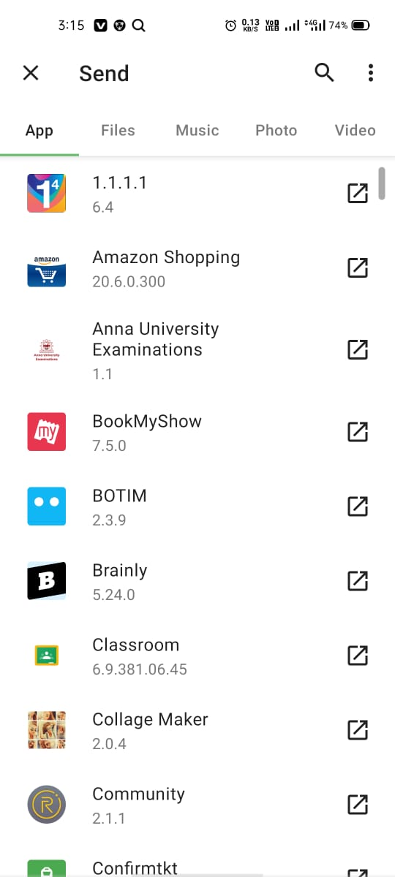
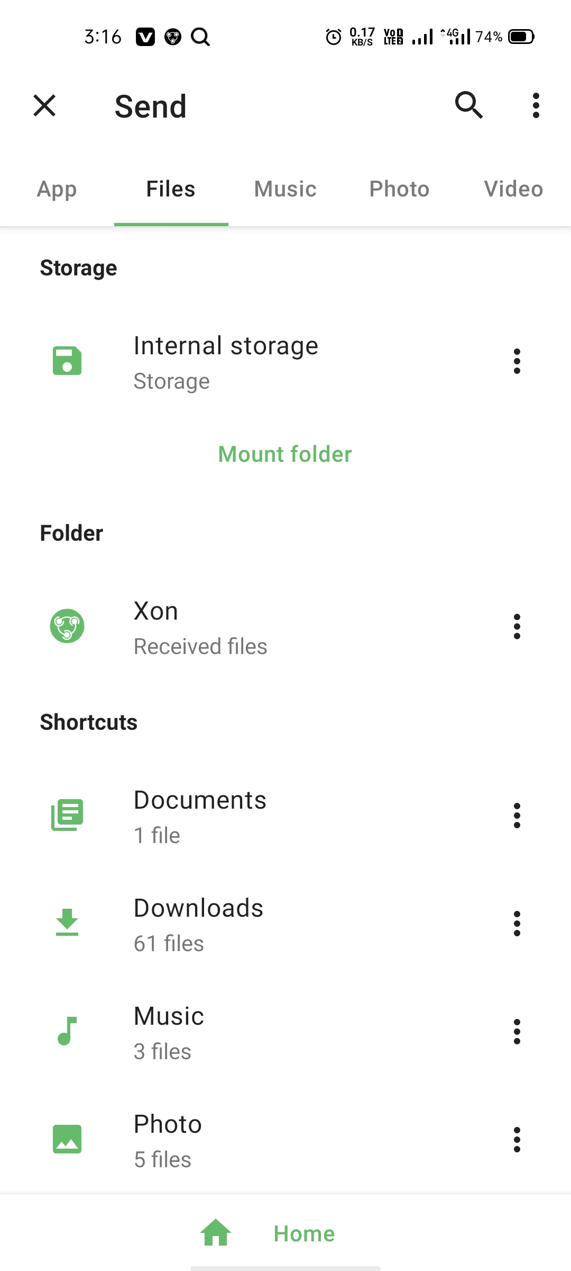
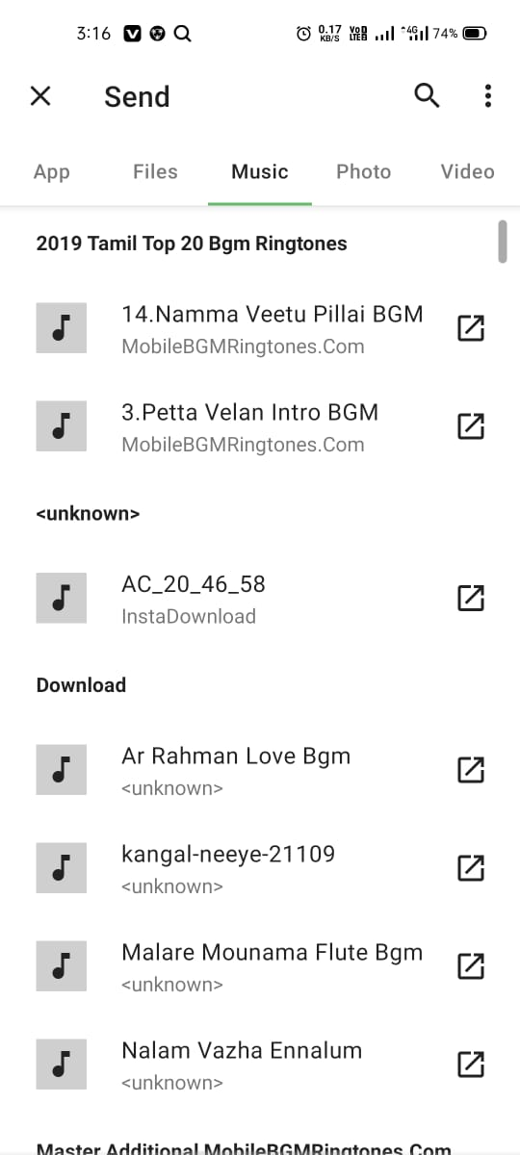
3.Sender page

Slide 22
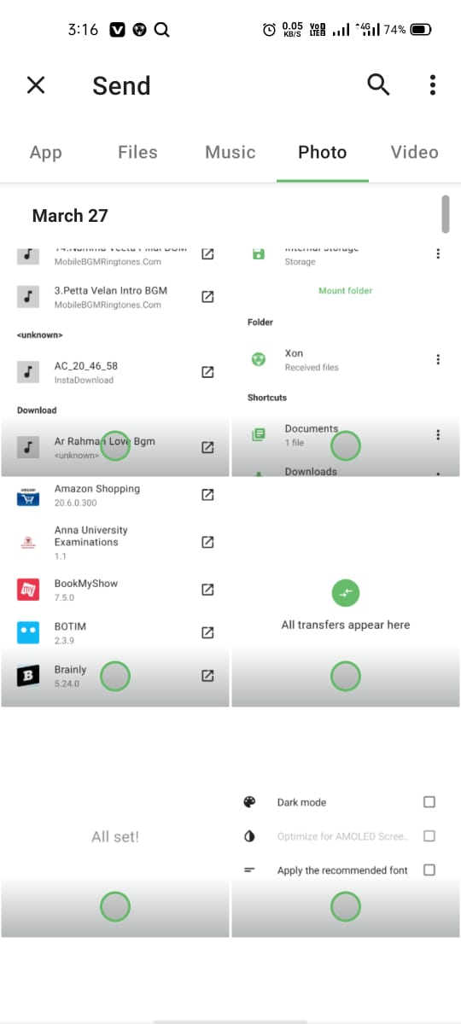
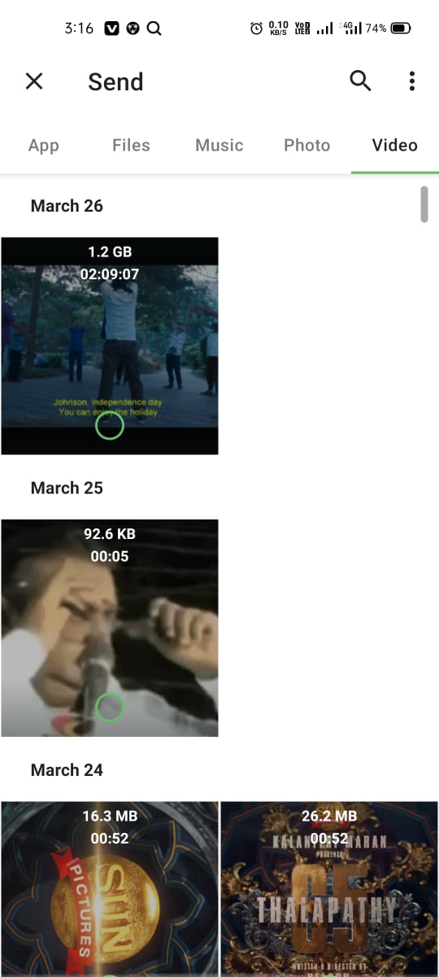
3.1.Sender page

Slide 23
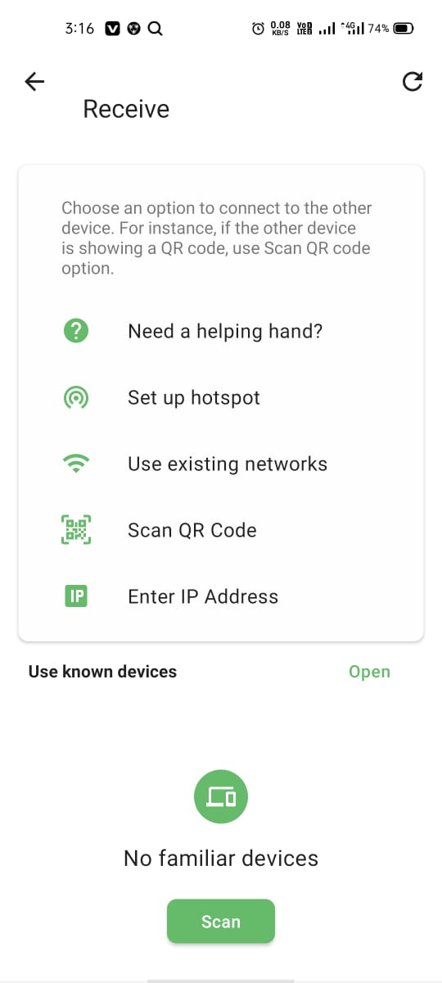
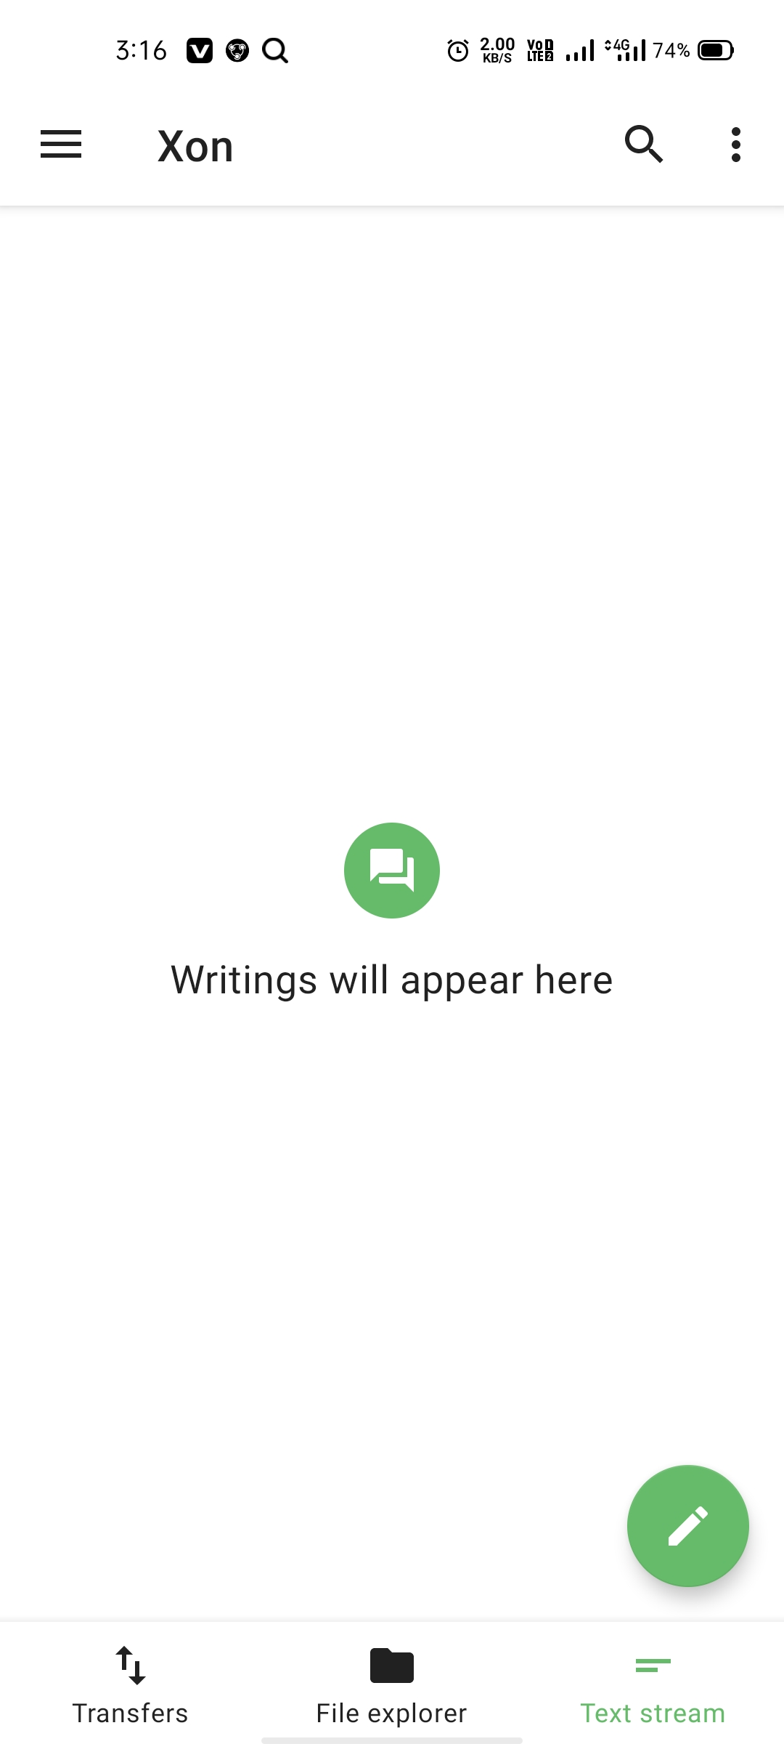
4. Receiver Page

Slide 24
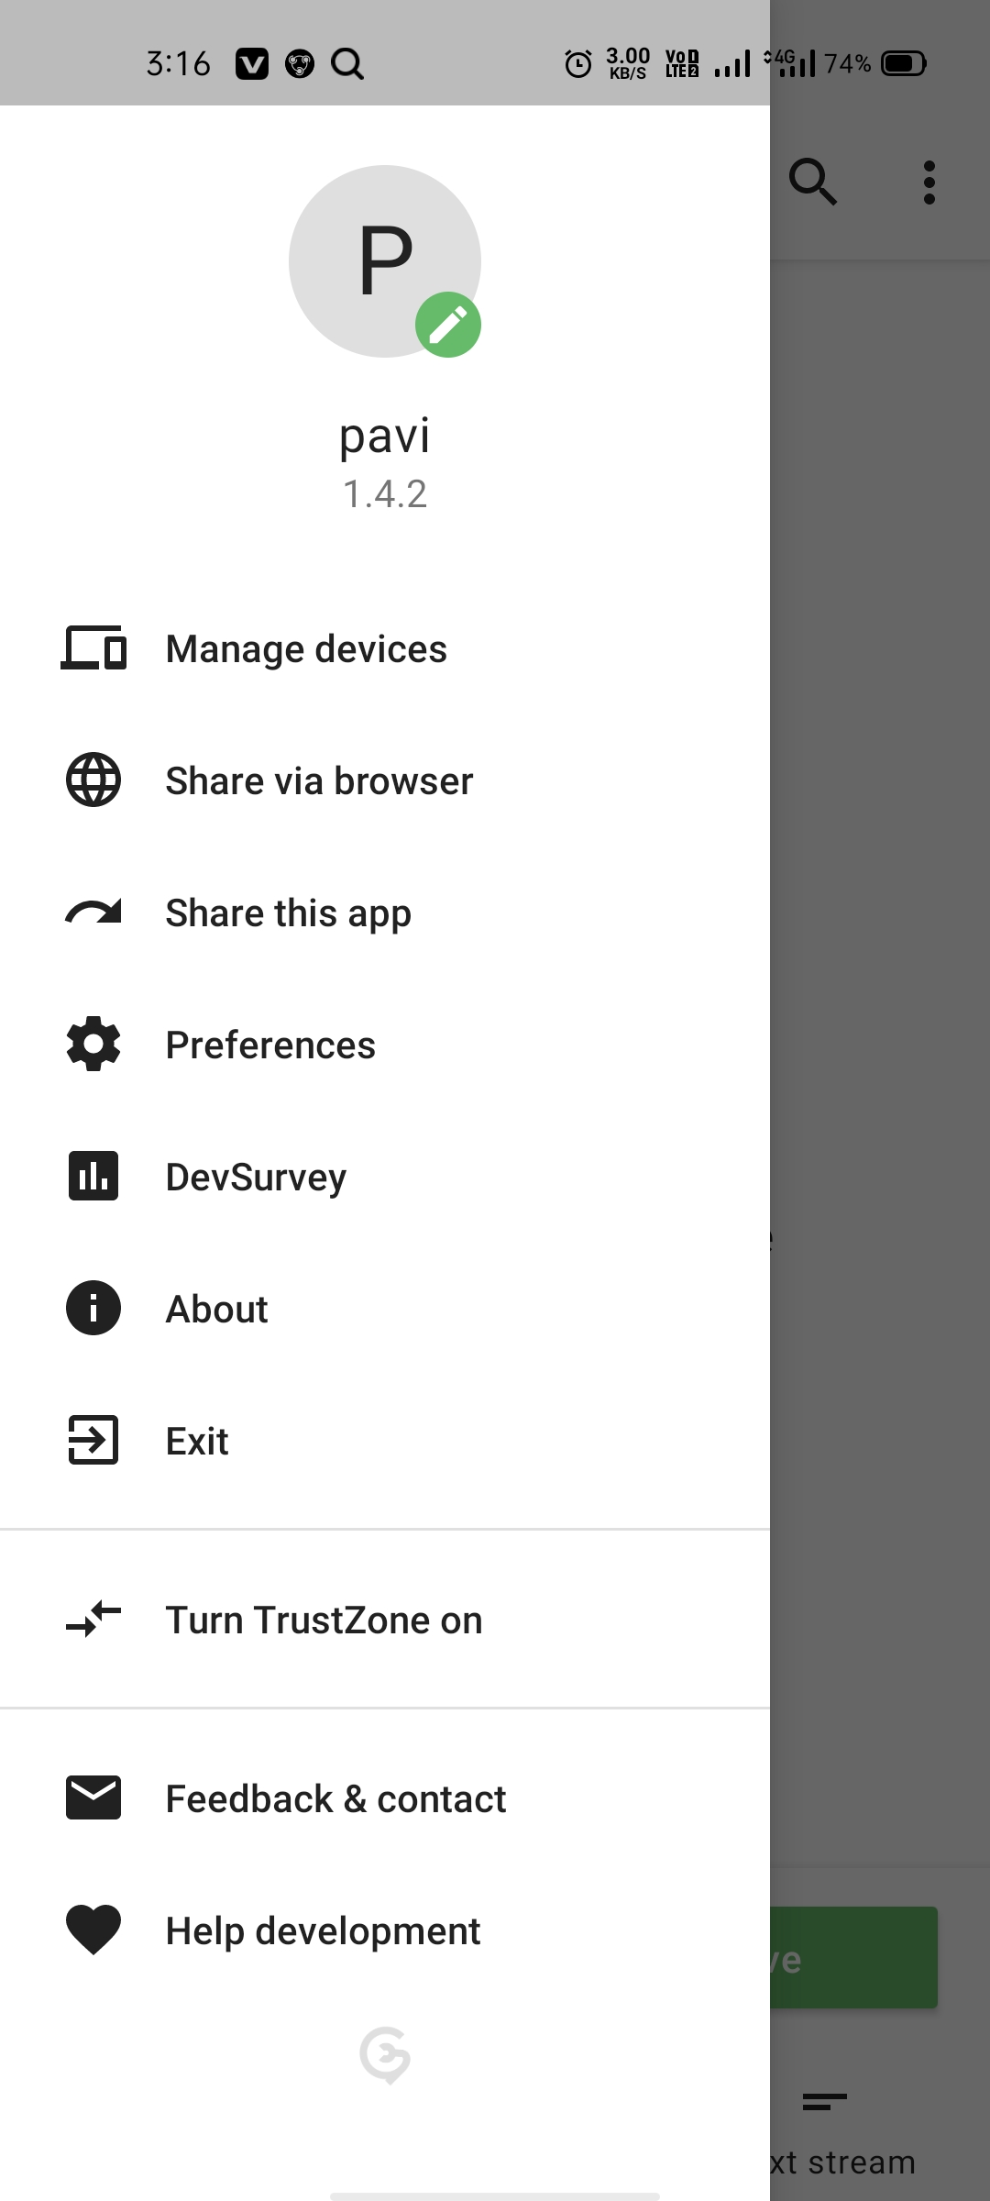
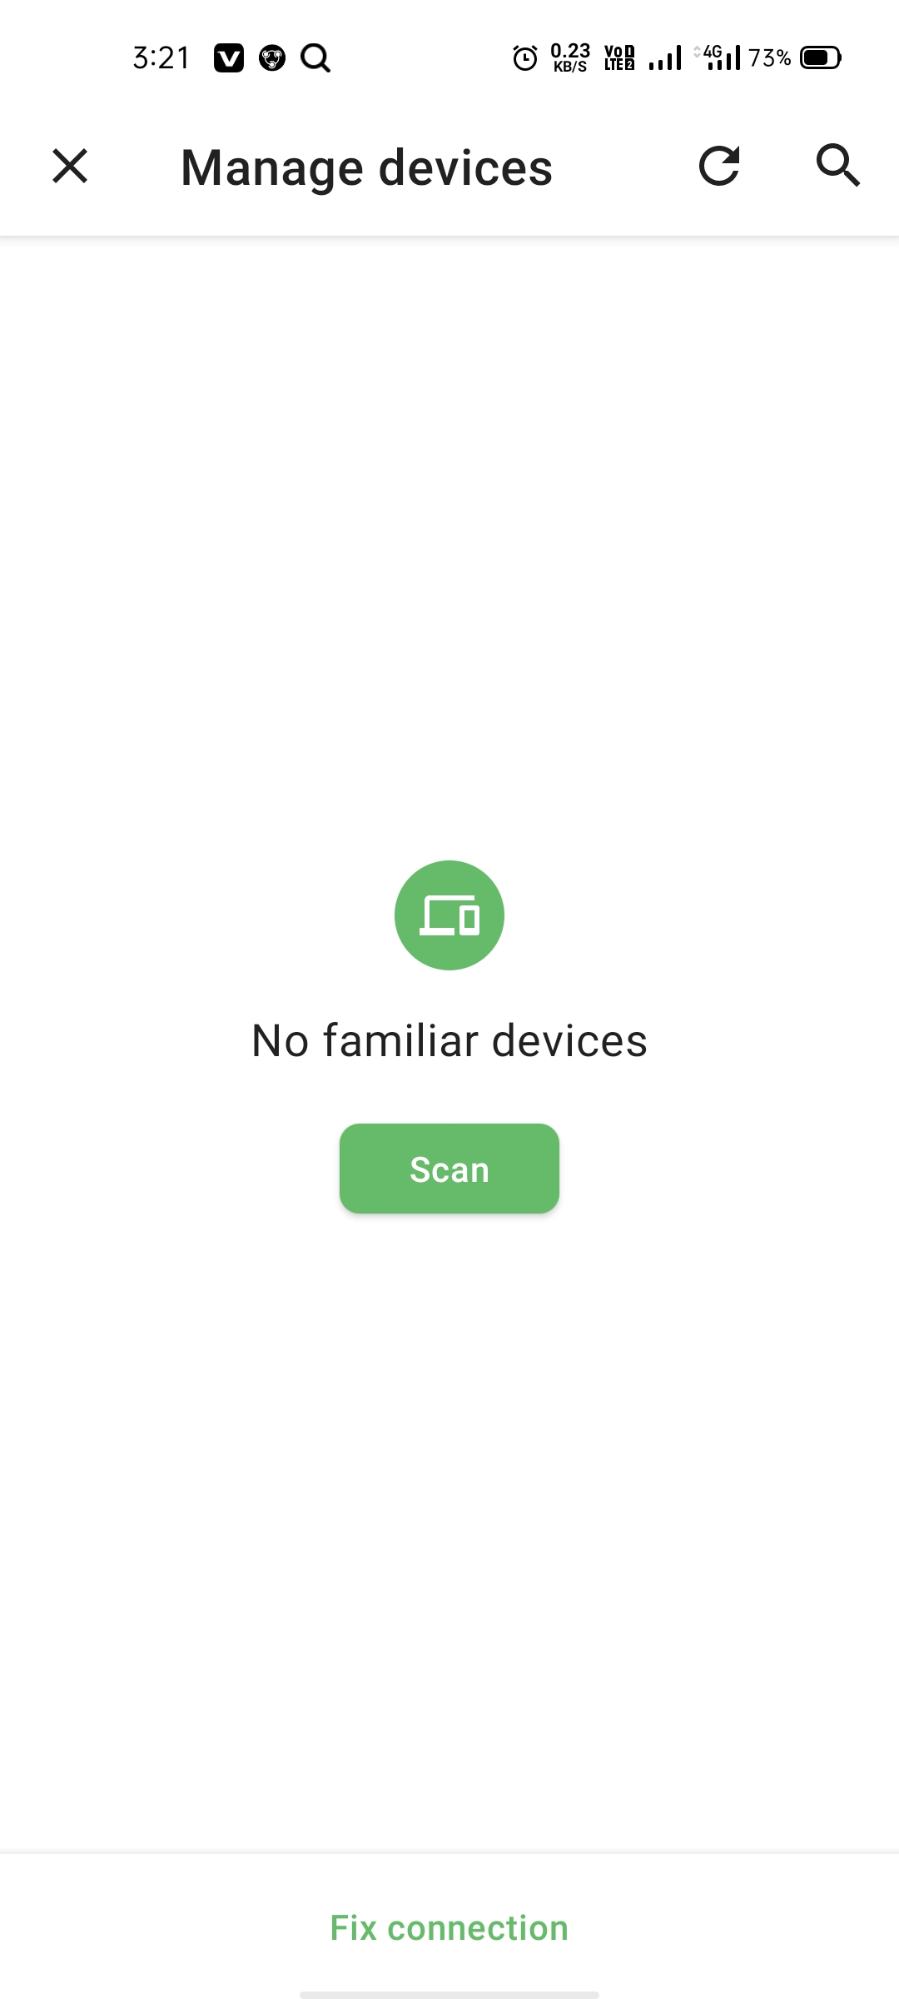
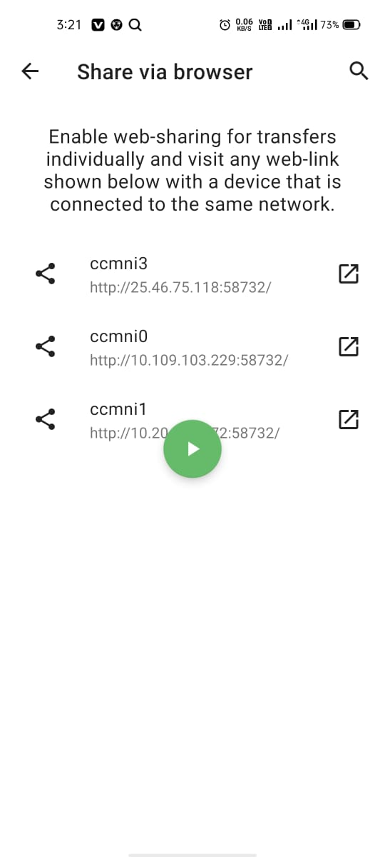
5.Menu

Slide 25
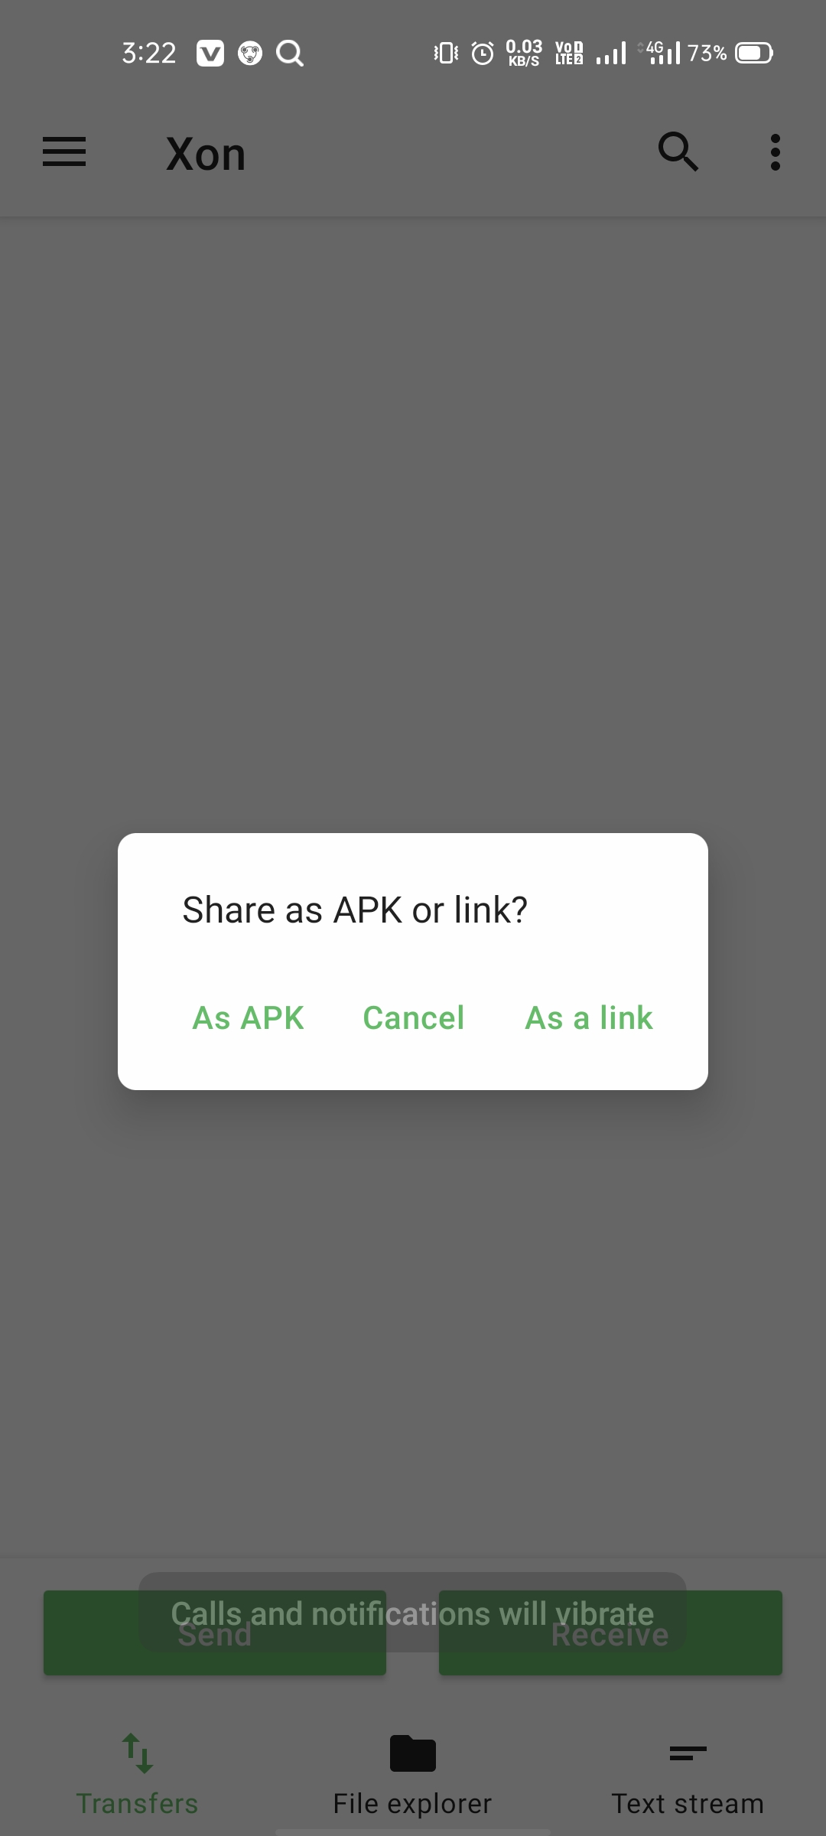
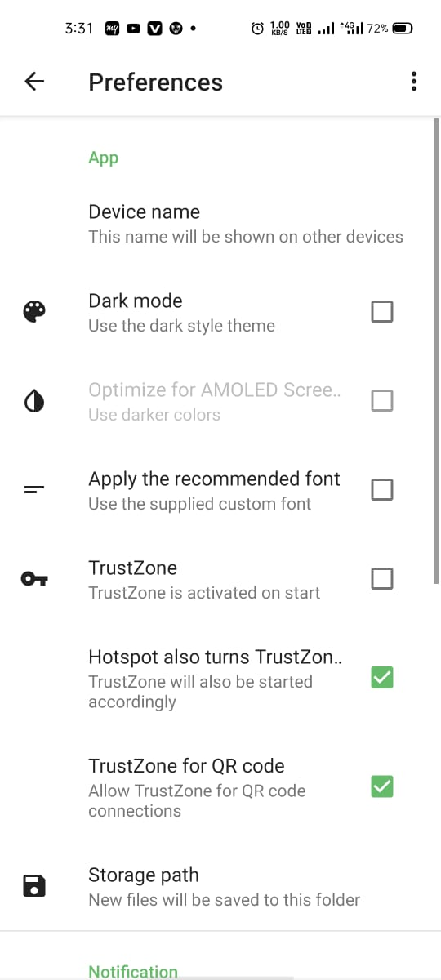
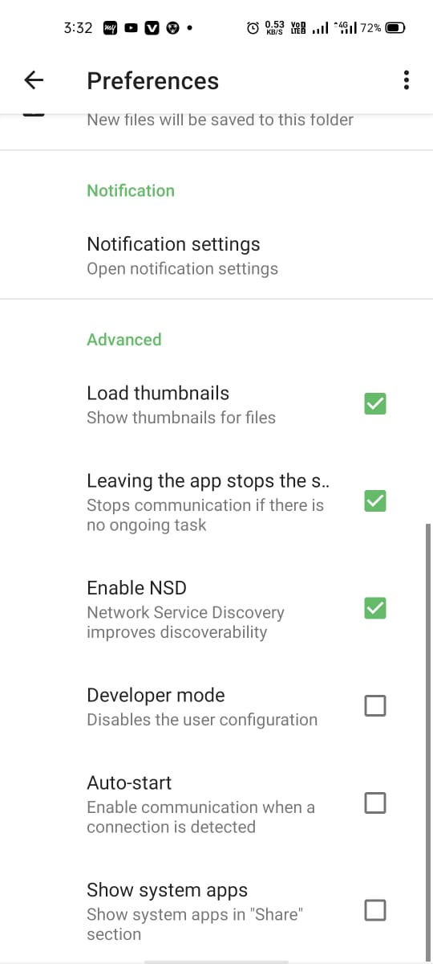
5.1.

Slide 26
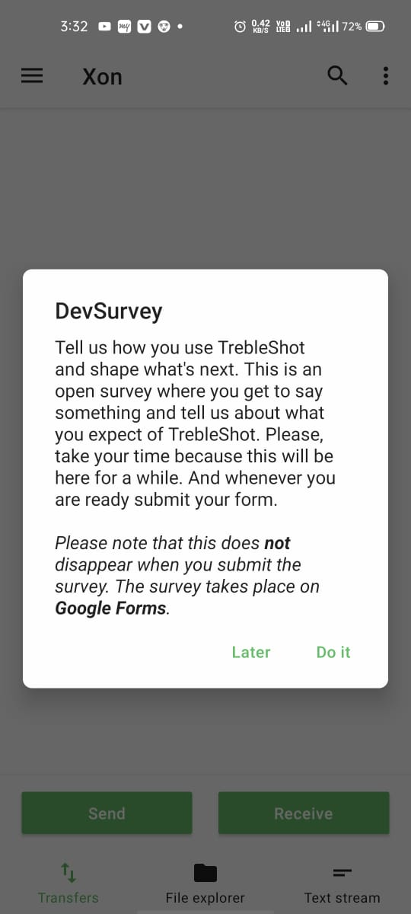
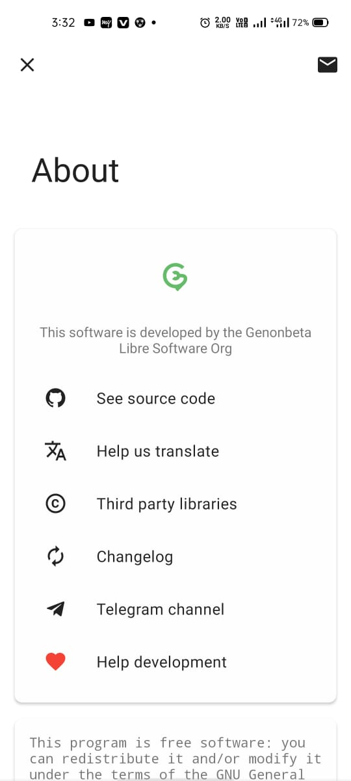
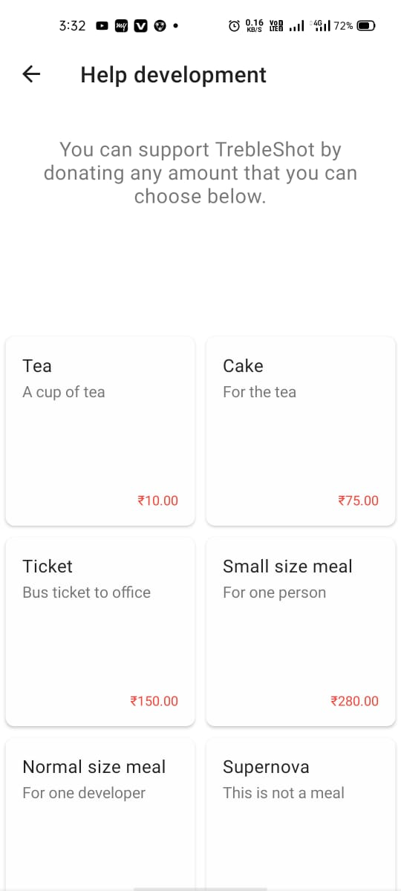
5.2

Slide 27
References:
Mysql
https://www.mysql.com/
Figma
https://www.figma.com/resources/learn-design/
Android Studio
https://developer.android.com/reference/packages.html
To download android studio
https://developer.android.com/studio?gclid=CjwKCAjwr_uCBhAFEiwAX8YJgatncJcrAkW2s0tN9t5TGZggy_VIBZqRQQoIYAnPL4ig2K69xMwfqhoCnZwQAvD_BwE&gclsrc=aw.ds
Genymotion
https://docs.genymotion.com/desktop/latest/01_Get_started.html#requirements
To download Genymotion
https://www.genymotion.com/download/
Java
https://docs.oracle.com/javase/tutorial/

Slide 28
conclusion:
The application of Xon which helps us to share files between two or more people. It may fulfill the user’s needs and give them satisfaction through our application.we are aimed to improve our application to long distance file sharing application and also we are going add automatically file erasable timer.

Slide 29
Thank You!

